Slide 1
Dynamic tool for Visualizing Weather Conditions
Malhar Patel
Aniket Verma
Sai Akhil Tekuri

Slide 2
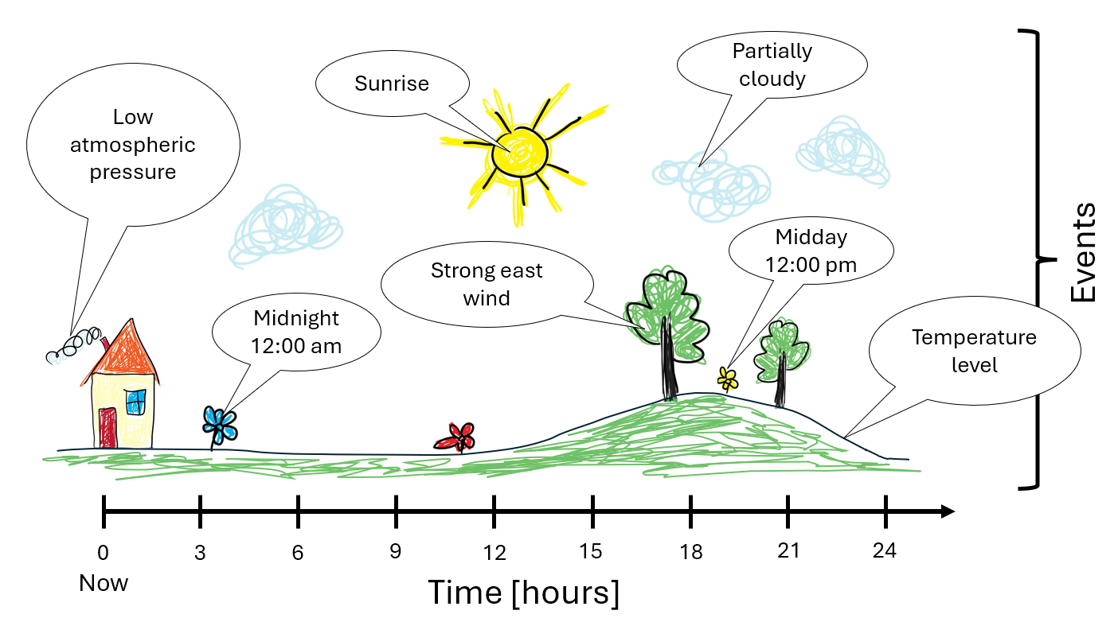
Project Goals
To create a dynamic, appealing tool to visualize weather conditions (24hrs) at your location.
Display weather conditions (temperature, precipitation, cloud cover) using visual cues that represent weather transitions throughout the day.
Real time updates, 24-hour weather forecasts.
An interaction to select hours from now (visualization changes according to the selected time)

Slide 3
Planned Approach
Data Collection
Fetch hourly weather data using a reliable Weather API
Visualization Libraries/Engines (under consideration)
Pillow: For basic image processing.
Pygame: Enables real-time updates and animations.
Matplotlib, Plotly or Manim: Potentially for timeline visuals.
UI Libraries: Tkinter or PyQt5 for any UI elements.
Feature Implementation
Develop dynamic sprites and animate to create indicators like the sun, clouds, wind, precipitation, temperature, etc.
Slide bar to pick hours from now, fetch weather conditions at that hour and update indicators accordingly in real-time.

Slide 4

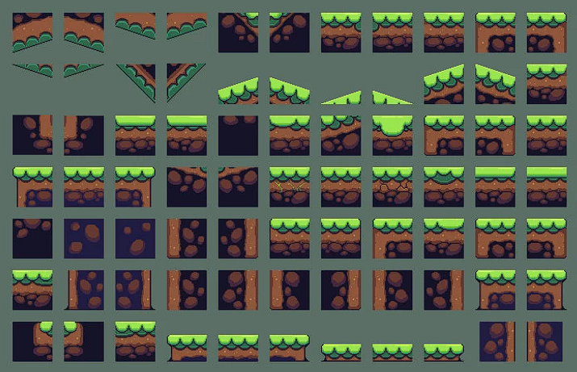
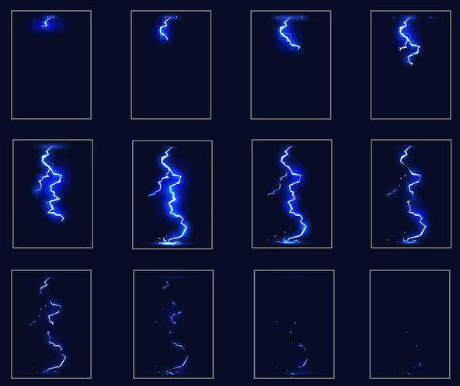
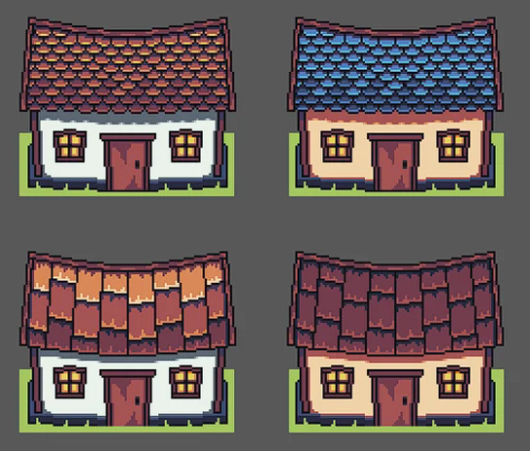

Possible Sprites

Slide 5
Expected Timeline
Date | Task
Nov 7 | Finalize API source and data standards
Nov 14 | Finalize library/engine and start coding core visuals
Nov 30 | Develop timeline display and landscape transitions
Dec 9 | Implement real-time tool updates
Dec 11 | Final testing and project wrap-up

Slide 6
Division of Labor
Akhil - Develop Pygame sprites for dynamic indicators
Malhar - Develop Pygame animations for dynamic indicators
Aniket - Data Processing (API Calls), Backend integration (with slider to select hours from now)
Stretch Goals
Support multiple locations or themed visuals (urban, rural, etc.).
More sprites
Integrate Rainmeter wallpaper SDK

Slide 7
References
Pygame: https://www.pygame.org/news
Rainmeter: https://www.rainmeter.net/
Open Weather API: https://openweathermap.org/api

